Slide 1
Project 1:
Land use planning - Participatory planning and land-based resource use conflict management for sustainable growth of Dar es Salaam metropolitan and its region
Fredrick B. Magina
Oswald Devisch

Slide 2
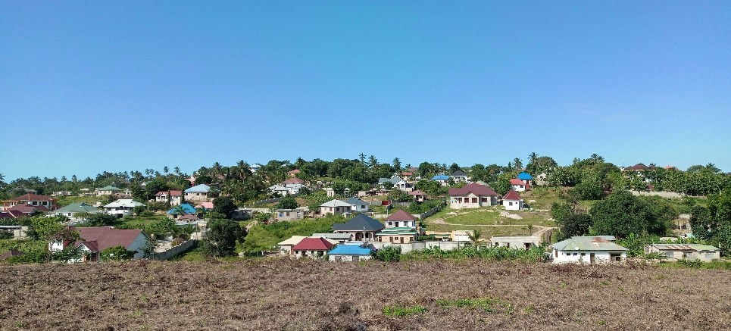
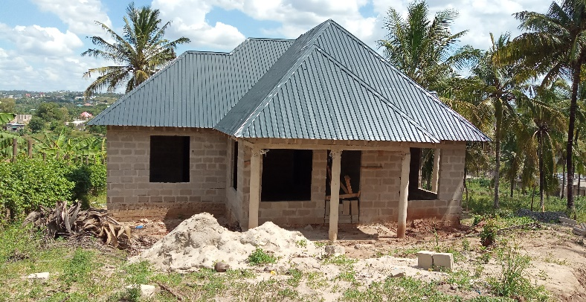
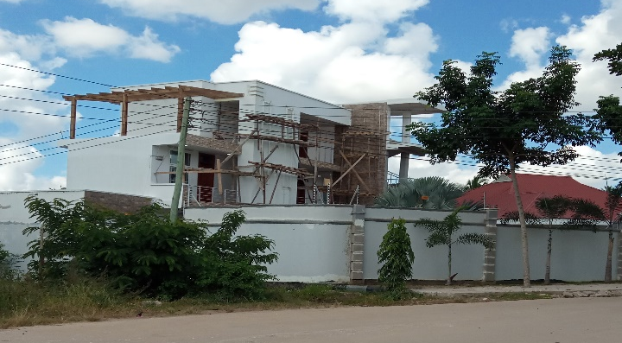
Planning challenges
Urban areas face challenges in physical planning - lack of proper land use plans and ineffective urban development control

Slide 3
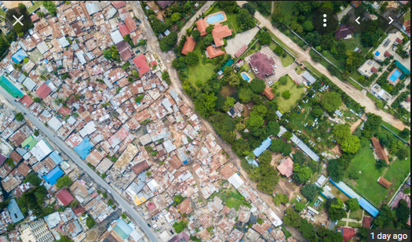
Planning challenges
These have led to growth of informal settlements, un-organised and unproductive land uses, and land use conflicts.

Slide 4
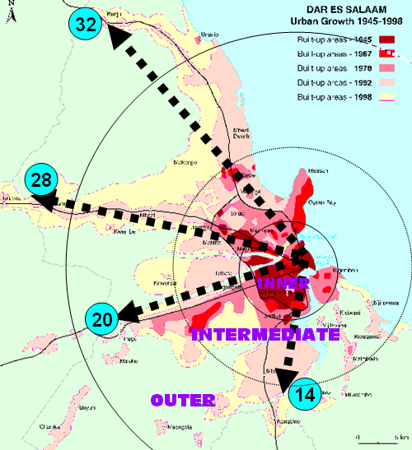
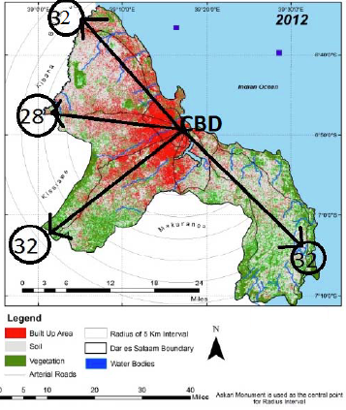
Planning challenges
Rapid urbanization of cities, other urban centres which surround cities and form the rural-urban linkage.
This culminates into:
  sprawling cities beyond the servicing capacity;
  dysfunctional city structures and urban service ecosystems and;
  challenges in land governance both in cities and rural areas.

Slide 5
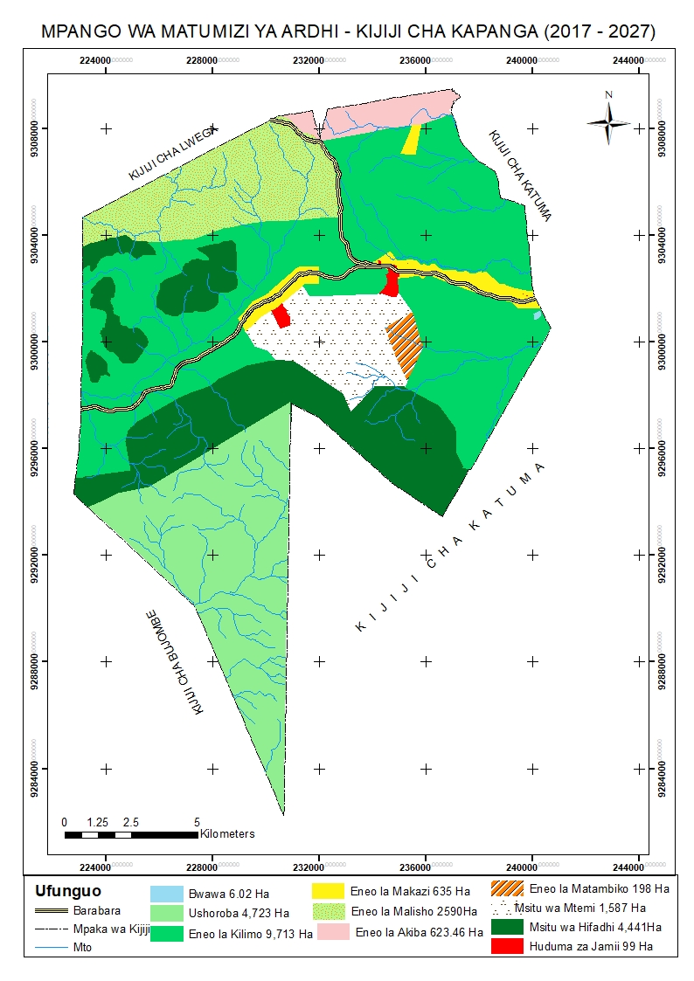
Planning challenges …
In rural areas, regional (village) planning is conducted as a way to confirm land uses
The science component, such as land capability (suitability) assessment to make suggestions on best land use options, is missing.
The ultimate result is land use conflicts
Cattle grazed in a maize farm

Slide 6
The challenges…
Cadastres which support physical and land use planning do not sufficiently address the current planning users’ needs.
A need to develop a participatory planning and conflict management framework for resolving land use issues and effectively undertake development control for the purpose of conserving the environment and ensuring liveable cities.

Slide 7
Objectives
Develop capacity in research, education and societal outreach on participatory planning and land-based resource use conflict management; and
Promote equitable and sustainable use of land resources so as to improve the spatial and socio-economic environment of Dar es Salaam city and its wider region.

Slide 8
Medium-term achievements (5 yrs)
Model the sprawl and growth trends of DSM city and driving factors from 2005 to 2026 so as to understand mechanisms triggering rapid urban development by using the Mobile Monitoring Approach.
Analyse past and present land-use planning practices, social behaviours and the subsequent spatial, social and economic impacts from 2005 to 2026.
Explore land-based resource use conflicts and management approaches with the application of approaches such as Artificial Intelligence, Mobile Monitoring and Internet of Things (IoT).
Develop capacity of land users on the use of participatory mapping technologies, data analytics and earth observation data for monitoring and debating rapid urban development by 2031.

Slide 9
Long-term achievements (10yrs)
A conception of a viable integrated planning approach, a sustainable spatial and socio-economic development of land users.
Attain minimization of land use conflicts in local communities who are end-users of land resources.
Improve capacity of local authorities and NGO’s to use Big Data Analytics, Mobile Monitoring and Internet of Things (IoT) approaches and SSIC for transforming urban (and rural) communities to sustainable digitally driven communities.

Slide 10
Long-term achievements (10yrs)…
8 PhD and 8 masters produced,
at least 16 peer reviewed publications,
16 conference contributions and two policy briefs produced,
one interdisciplinary research group formed and one master’s programme running.
Establish a participatory land use and conflict management platform and one practitioners manual on resource use conflict management.
At least 200 members of the community will be trained on participatory planning.

